Slide 1
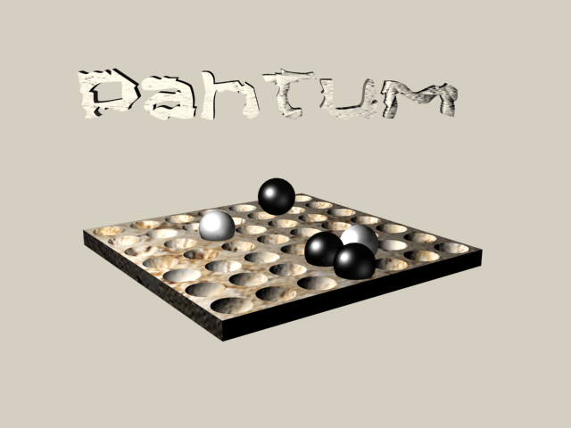
Pahtum comments /mobile game for Android based on J2ME game

Slide 2

Language
Game will support EFIGSP languages (English, French, Italian, German, Spanish, Portuegese)
In settings menu there must be language selection menu
At first start of the game, it should ask you to select the language, but only fist time the game is run

Slide 3



Intro screen
Game should have loading progress bar
Loading from 0-100%, copyright notice missing
©by Cocoasoft 2003-2012
Intro screen should be from J2ME game
Icon is missing, Cocoasoft logo is squized
There will be 2 logos at game start(Cocoasoft and another one, game logo or publishers, name it logo2)

Slide 4
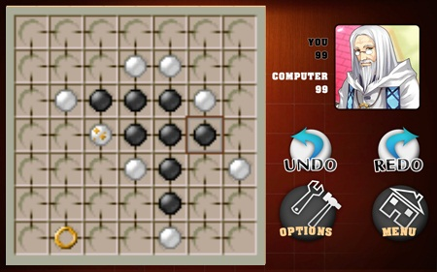

Main game look
Game table should look like it is from marble, do rectangle around, see sample of my proposal
Keep in mind, that this is around 3800 years old game, found in Mesopotamia, it should have old look http://en.wikipedia.org/wiki/Pah_Tum

Slide 5
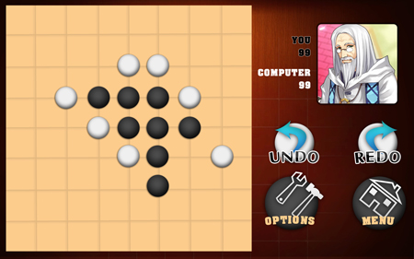
Main game
When opponent placing stone/piece, it should wait for 2-3 sec, put somwhere „Thinking!“ than „You“ (buttons undo/redo go out)
Scoring should be according to Wiki:
1 piece = 0 points
2 pieces = 0 points
3 pieces = 3 points
4 pieces = 10 points
5 pieces = 25 points
6 pieces = 56 points
7 pieces = 119 points

Slide 6
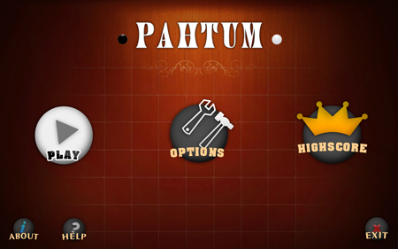
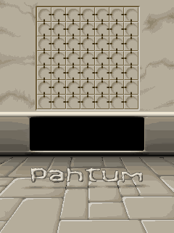
Background image
Brown background image should be change to the marble image from J2ME game
Use only colours that close to colours in J2me game, dont use blue, red colours in game, except for opponents

Slide 7





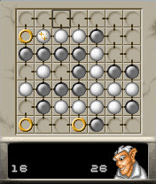





Main game screen
Golden ring should be similar to J2Me game
Opponents should be taken from J2Me game

Slide 8
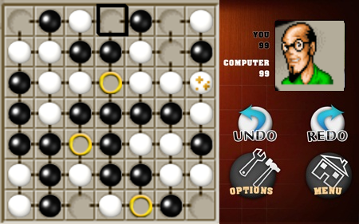
Main screen look

Slide 9
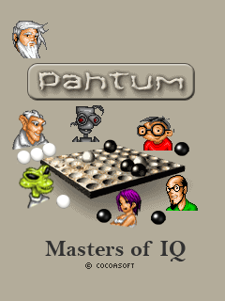
Intro new

Slide 10
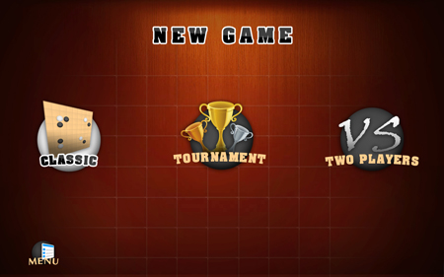
Fonts
Same fonts over whole game should be used in the game, now different fonts appear, not same fonts. Use old look fonts like marked here
This font is OK
This font Not OK

Slide 11
Game menu
Undo /redo should be removed, once you put the piece/stone, there is no way back. Player should think before does the move.

Slide 12
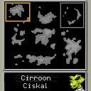
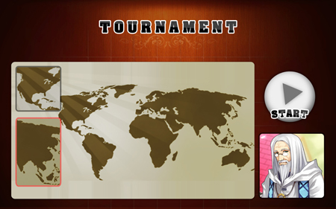
Tournament map
Should be changed to look the similar as in J2ME game

Slide 13
Menu
Play button should be in the centre
There will be a need for language selection in menu
Options/settings & high scores should be small buttons beside about and help
buttons should have look of the white or black stones like in the game

Slide 14
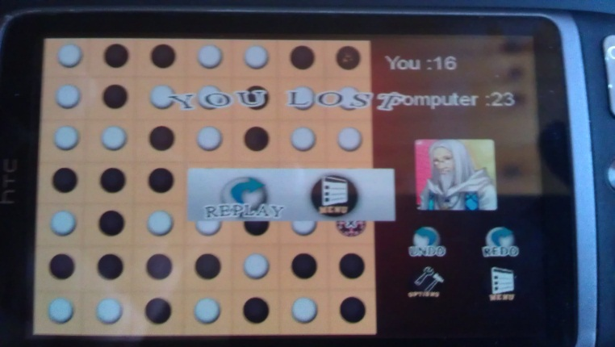
Win/lose screen
You win and You lose screen are not ok, there should be font used that looks older,
Avoid to use non natural colours in game, in win / lose screen there are Red and Blue, they are not OK.
There should be pup up dialog, it must not be transparent, make a similar rounded rectangle as shown here on right side with menu and replay buttons, this should be about same ratio as shown.
You win/ lose
You 15 score / opponent 12
Replay / Menu

Slide 15
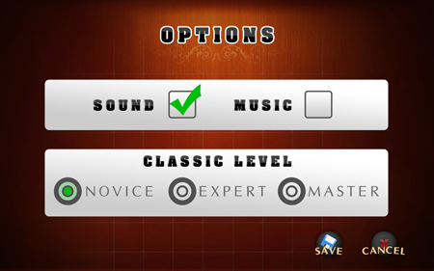
Setting menu
Green should be replaced with other, maybe black colour, Green colour here is NOT OK

Slide 16
Help sceen
Put there image of pah tum from logo and text

